Slide 1
Single cell coating of fungal blastospores – A promising approach to increase desiccation tolerance
Robin Dietsch
Desirée Jakobs-Schönwandt
Alexander Grünberger Anant Patel

Slide 2




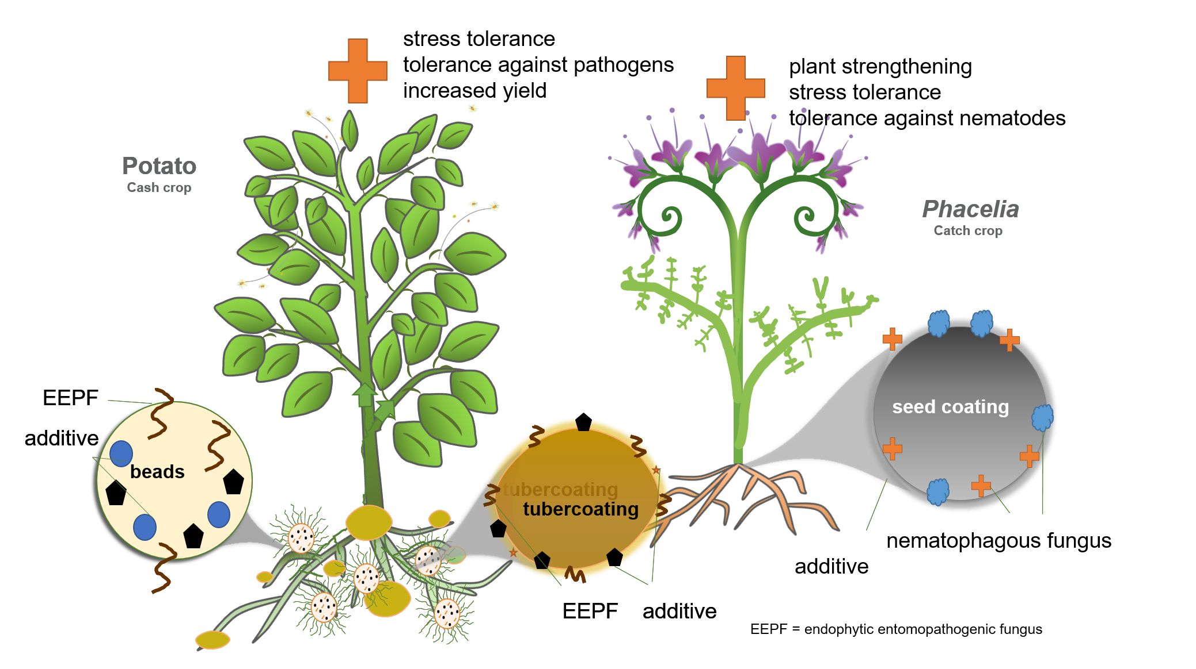
FORK-Project
Metarhizium brunneum CB15-III
1

Slide 3
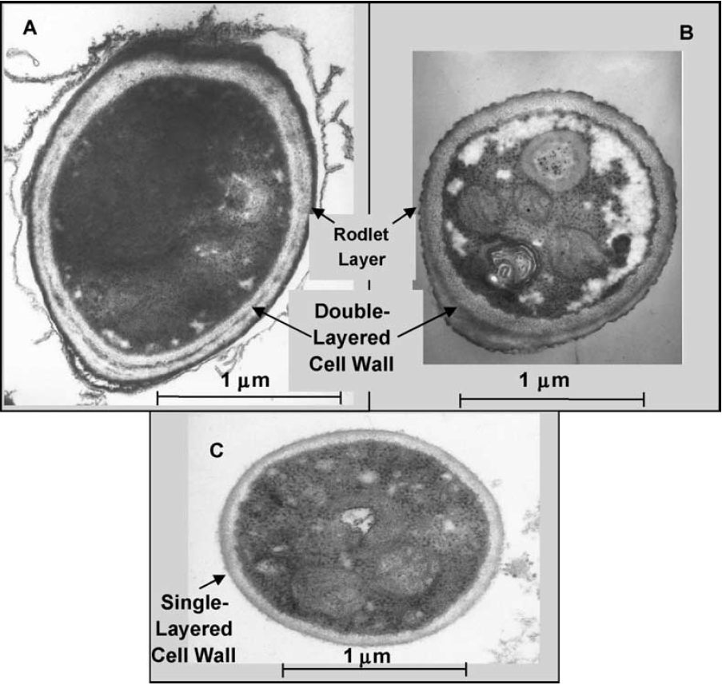
Problem/Importance of the research
Aerial Conidium
M. brunneum blastospores:
easy, cheap and highly efficient fermentation [2,3]
low desiccation tolerance [1]
desiccation necessary for sufficient shelf life [2,4,5]
„opposite“ of aerial conidia
Desiccation and Rehydraton:
drying weakens cell membrane -> loss of fluidity [6-9]
rehydration destroys cell membranes (ruptures, depolarization) [6-9]
rehydration speed/method has high impact on viability
rehydration often overlooked in product design
Blastospore
Fig. 1: Transmission electron micrographs of typical (A) aerial conidium and (C) blastospore of M. anisopliae var. acridum. [1]
2

Slide 4
Impact of rehydration speed/method
Immediate Rehydration
Decelerated Rehydration
Water Vapor
Water
blastospores + support (dry)
blastospores + support (dry)
a
b
n = 5
Anova + post-hoc Tukey test; p<0.001
error = standard deviation
Water reservoir
3

Slide 5
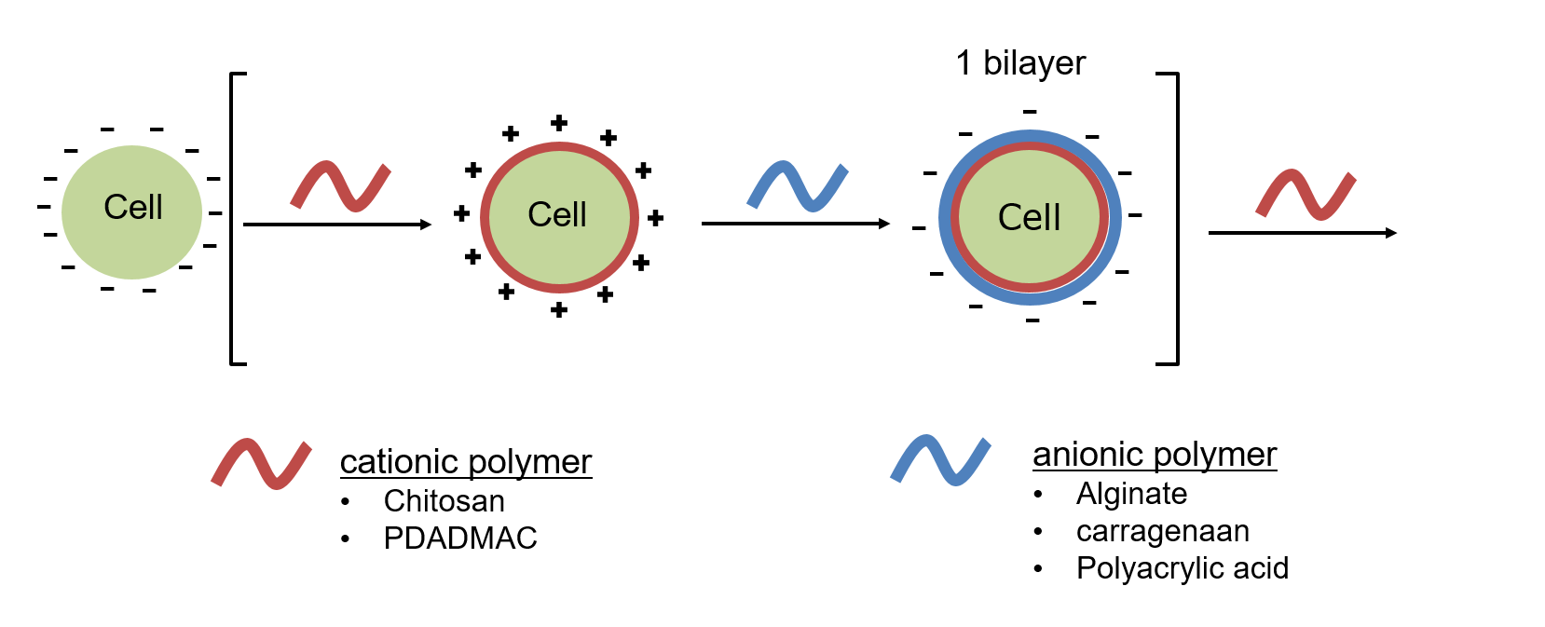
Can rehydration be affected during production?
Aerial Conidium
Blastospore
Concept: Polymer coating of cells.
Working Hypothesis
The addition of a single or multiple polymer layers on top of the blastospore’s single layered cell wall acts as a supplementary diffusion barrier, slowing H₂O influx during rehydration.
This leads to an increase in viability after drying and rehydration.
Fig. 1: Transmission electron micrographs of typical (A) aerial conidium and (C) blastospore of M. anisopliae var. acridum. [7]
4

Slide 6
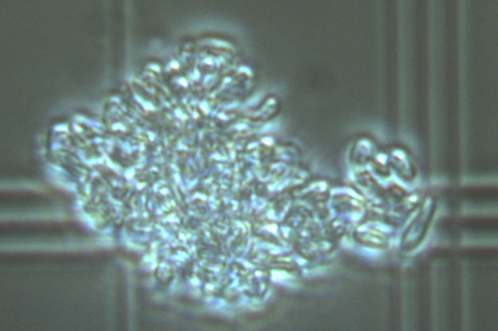
Performance of coating
Experimental Setup:
0 – 5 bilayers
chitosan: 110-270 cp
alginate: 200-800 cp
„medium“ chain length
Results:
increase in desiccation tolerance with increase in layers: 6,88% -> 27,4%
observation: increase in aggregation with increase in layers
n = 9, Anova + post-hoc Tukey test; p<0.05, error = standard deviation
5

Slide 7
Optimization – Chain length
polymer chain length [10]
short: dense, but thin
long: porous, but thick
Hypothesis: short > long
Experimental Setup:
3 bilayer: chitosan + alginate
different polymer chain lengths
Alginat: Chitosan:
short: 40-90 cp 20 -300 cp
medium: 110-270 cp 200-800 cp
long: 350 – 550 cp 800-2000 cp
Results
decreasing viability with increasing chain length
observation: aggregation increases with chain length
→ short chain polymers reduce formulation loss
n = 10
Kruskal-Wallis-Test; p<0.05
error = standard deviation
n = 8
Tukey-Test; p<0.05
error = standard deviation
6

Slide 8
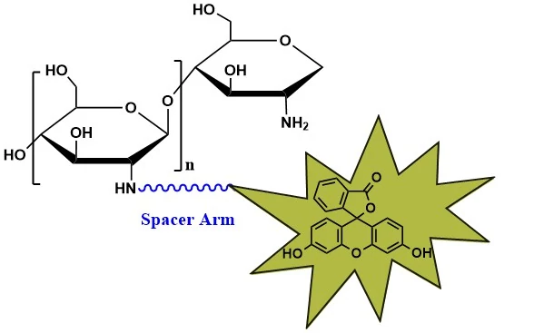
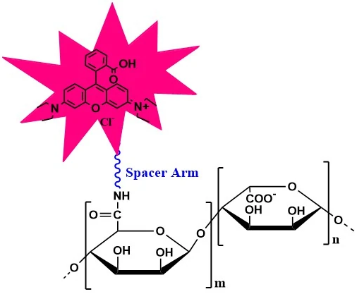
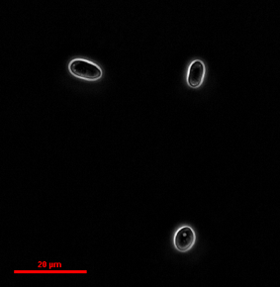
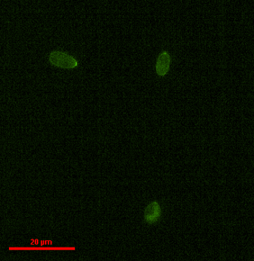
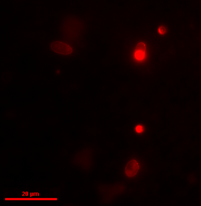
Verification – Fluorescence tagged Polymers
Experimental Setup:
1 & 3 Bilayer
FITC-Chitosan + Rhodamine Alginate on 1st/3rd bilayer
short chain length
Hypothesis: Coated Blastospores are visible in green and red fluorescence channels.
FITC-Chitosan
Rhodamine-Alginate
Bilayer 1:
Phase contrast
GFP Channel
mCherry Channel
7

Slide 9
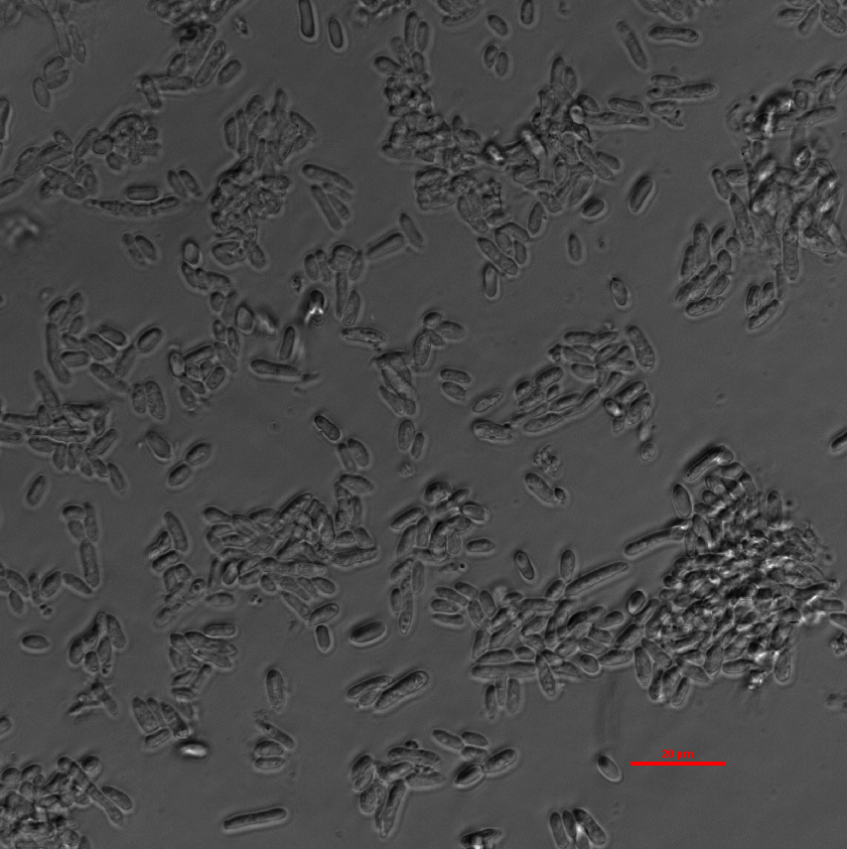
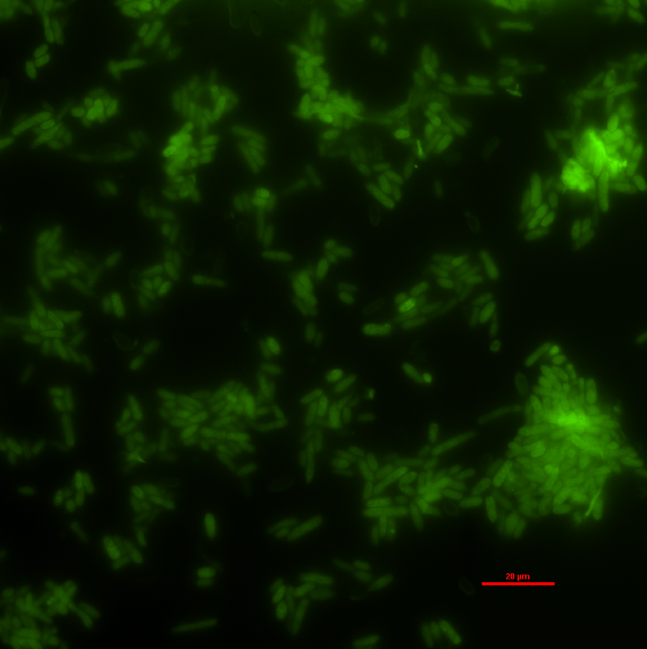
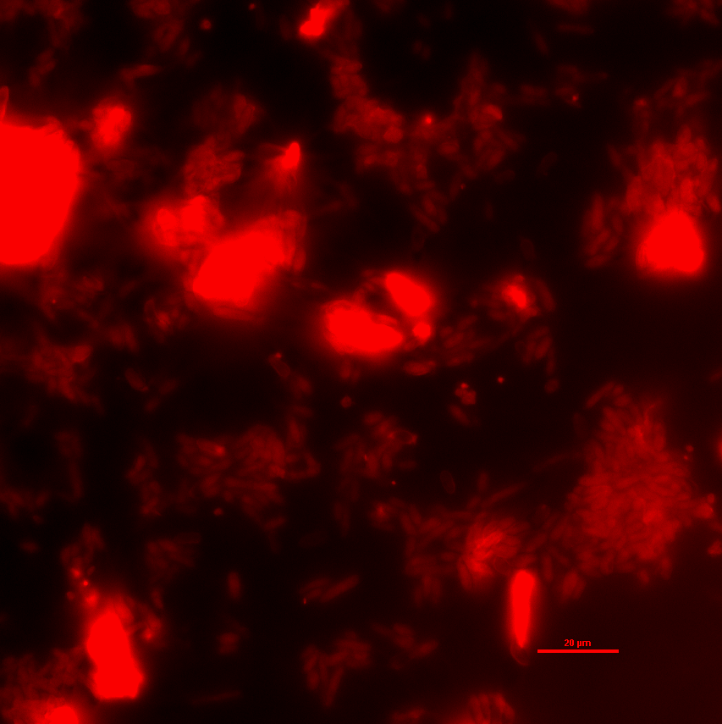
Verification – Fluorescence tagged Polymers
Experimental Setup:
1 & 3 Bilayer
FITC-Chitosan + Rhodamine Alginate on 1st/3rd bilayer
short chain length
Hypothesis: Coated Blastospores are visible in green and red fluorescence channels.
FITC-Chitosan
Rhodamine-Alginate
Bilayer 3:
Phase contrast
GFP Channel
mCherry Channel
7

Slide 10
REM
Uncoated
Coated
8

Slide 11
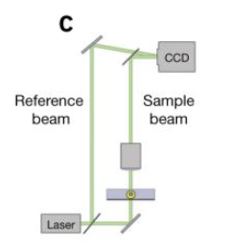
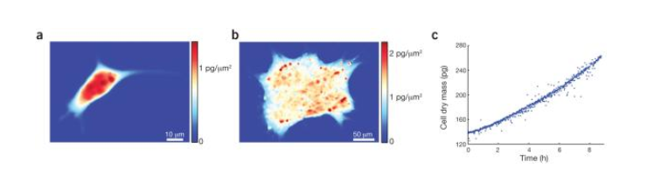
Next steps
Investigation of de- and rehydration kinetics via Mass Density Interferometry (MDI)
processing and interpretation of interference pattern of sample and reference beam
usual use: calculations of cell density (dry weight),
but also de- and rehydration kinetics possible!
storage studies
Possible Setup for interferometry-microscopy
https://www.ncbi.nlm.nih.gov/pmc/articles/PMC4319180/
Data generated through MDI. https://www.ncbi.nlm.nih.gov/pmc/articles/PMC4319180/
9

Slide 12
References
Leland, J.E., Mullins, D.E., Vaughan, L.J., Warren, H.L., 2005. Effects of media composition on submerged culture spores of the entomopathogenic fungus, Metarhizium anisopliae var. acridum Part 2: Effects of media osmolality on cell wall characteristics, carbohydrate concentrations, drying stability, and pathogenicity. Biocontrol Sci Techn 15, 393-409.
Jaronski, S. (2013). Mass production of entomopathogenic fungi—state of the art. Mass Production of Beneficial Organisms: Invertebrates and Entomopathogens. J. A. Morales-Ramos, M. Guadalupe Rojas and D. I. Shapiro-Ilan, Academic Press, San Diego: 357-413.
Iwanicki, N. S. A., et al. (2020). "Growth kinetic and nitrogen source optimization for liquid culture fermentation of Metarhizium robertsii blastospores and bioefficacy against the corn leafhopper Dalbulus maidis." World J. Microbiol. Biotechnol. 36(5): 1–13.
Holder, D.J., Kirkland, B.H., Lewis, M.W., Keyhani, N.O., 2007. Surface characteristics of the entomopathogenic fungus Beauveria (Cordyceps) bassiana. Microbiology+ 153, 3448-3457.
Jackson, M.A., Erhan, S., Poprawski, T.J., 2006. Influence of formulation additives on the desiccation tolerance and storage stability of blastospores of the entomopathogenic fungus Paecilomyces fumosoroseus (Deuteromycotina : Hyphomycetes). Biocontrol Sci Techn 16, 61-75.
Lebre, P.H., De Maayer, P., Cowan, D.A., 2017. Xerotolerant bacteria: surviving through a dry spell. Nat. Rev. Microbiol. 15, 285–296.
Potts, M., 1994. Desiccation Tolerance of Prokaryotes. Microbiol Rev 58, 755-805.
Rangamani, P., et al. (2014). "Lipid Tilt Regulates Ripple Phase Behavior in Lipid Bilayer." Biophys. J. 106(2): 509a.
Scheve, C. S., et al. (2013). "Steric Pressure between Membrane-Bound Proteins Opposes Lipid Phase Separation." J. Am. Chem. Soc. 135(4): 1185–1188.
Milkova, V., and T. Radeva. 2007. Effect of chain length and charge density on the construction of polyelectrolyte multilayers on colloidal particles. Vol. 308. J Colloid Interface Sci.
10

Slide 13
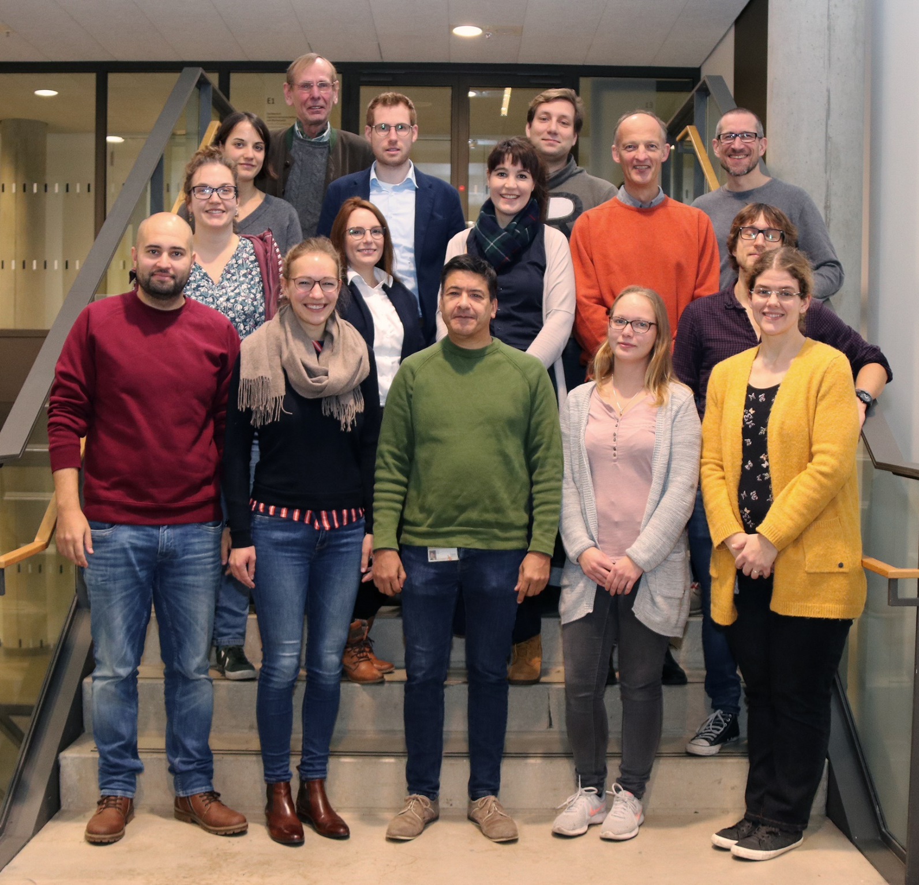




Thank you!
11

Slide 14
Problem/Importance of the research
M. brunneum is used as biocontrol agent [1,2]
endophytic entomopathogenic fungus, increases plant fitness [2]
mainly 2 infective propagules: Aerial conidia and blastospores [3]
over 70% of mycoinsecticides contain conidia or conida-mycelium mixtures [6]
blastospores:
high infectivity to insects AND plants[4-8]
easy, cheap and highly efficient fermentation (compared to aerial conidia)[9,10]
but:
low desiccation tolerance, necessary for sufficient shelf life [9,11,12]
shelf life of dried blastospores oftentimes unacceptable for profitable commercialization (2 years @ RT) [9,11,12]
shelf life significantly lower than aerial conidia [9,11,12]
Aerial Conidium
Blastospore
Fig. 1: Transmission electron micrographs of typical (A) aerial conidium and (C) blastospore of M. anisopliae var. acridum. [7]
2

Slide 15
References
Krell, V., Jakobs-Schoenwandt, D., Vidal, S., Patel, A.V., 2018. Cellulase enhances endophytism of encapsulated Metarhizium brunneum in potato plants. Fungal Biol-Uk 122, 373-378.
Vidal, S., Jaber, L.R., 2015. Entomopathogenic fungi as endophytes: plant-endophyte-herbivore interactions and prospects for use in biological control. Curr Sci India 109, 46-54.
Krell, V., Unger, S., Jakohs-Schoenwandt, D., Patel, A.V., 2018. Importance of phosphorus supply through endophytic Metarhizium brunneum for root:shoot allocation and root architecture in potato plants. Plant Soil 430, 87-97.
Alkhaibari, A.M., Carolino, A.T., Yavasoglu, S.I., Maffeis, T., Mattoso, T.C., Bull, J.C., Samuels, R.I., Butt, T.M., 2016. Metarhizium brunneum Blastospore Pathogenesis in Aedes aegypti Larvae: Attack on Several Fronts Accelerates Mortality. PLoS Pathog. 12, e1005715.
Carolino, A.T., Gomes, S.A., Pontes Teodoro, T.B., Mattoso, T.C., Samuels, R.I., 2019. Aedes aegypti Pupae are Highly Susceptible to Infection by Metarhizium anisopliae Blastospores. J Pure Appl Microbiol. 13, 1629–1634.
Jackson, M.A., McGuire, M.R., Lacey, L.A., Wraight, S.P., 1997. Liquid culture production of desiccation tolerant blastospores of the bioinsecticidal fungus Paecilomyces fumosoroseus. Mycol Res 101, 35-41.
Leland, J.E., Mullins, D.E., Vaughan, L.J., Warren, H.L., 2005. Effects of media composition on submerged culture spores of the entomopathogenic fungus, Metarhizium anisopliae var. acridum Part 2: Effects of media osmolality on cell wall characteristics, carbohydrate concentrations, drying stability, and pathogenicity. Biocontrol Sci Techn 15, 393-409.
Lohse, R., Jakobs-Schonwandt, D., Vidal, S., Patel, A.V., 2015. Evaluation of new fermentation and formulation strategies for a high endophytic establishment of Beauveria bassiana in oilseed rape plants. Biol Control 88, 26-36.
Reddy, G.V.P., Tangtrakulwanich, K., Wu, S.H., Miller, J.H., Ophus, V.L., Prewett, J., Jaronski, S.T., 2014. Evaluation of the effectiveness of entomopathogens for the management of wireworms (Coleoptera: Elateridae) on spring wheat. J Invertebr Pathol 120, 43-49.
Chong-Rodríguez, M., Maldonado-Blanco, M., Hernández-Escareño, J., Galán-Wong, L., Sandoval-Coronado, C., 2011. Study of Beauveria bassiana growth, blastospore yield, desiccation-tolerance, viability and toxic activity using different liquid media. African Journal of Biotechnology 10, 5736–5742.
Holder, D.J., Kirkland, B.H., Lewis, M.W., Keyhani, N.O., 2007. Surface characteristics of the entomopathogenic fungus Beauveria (Cordyceps) bassiana. Microbiology+ 153, 3448-3457.
Jackson, M.A., Erhan, S., Poprawski, T.J., 2006. Influence of formulation additives on the desiccation tolerance and storage stability of blastospores of the entomopathogenic fungus Paecilomyces fumosoroseus (Deuteromycotina : Hyphomycetes). Biocontrol Sci Techn 16, 61-75.
Boteva, E., Mironova, R., 2019. Maillard reaction and aging: can bacteria shed light on the link? Biotechnol. Biotechnol. Equip. 33, 481–497.
Laskowska, E., Kuczyńska-Wiśnik, D., 2020. New insight into the mechanisms protecting bacteria during desiccation. Curr. Genet. 66, 313–318.
Franks, F., 1988. Protein Hydration. SpringerLink, 127–154.
Lebre, P.H., De Maayer, P., Cowan, D.A., 2017. Xerotolerant bacteria: surviving through a dry spell. Nat. Rev. Microbiol. 15, 285–296.
Raghunathan, V.A., Katsaras, J., 1996. Lβ′→Lc′ phase transition in phosphatidylcholine lipid bilayers: A disorder-order transition in two dimensions. Phys. Rev. E 54, 4446–4449.
Rangamani, P., Katira, S., Smit, B., Oster, G., 2014. Lipid Tilt Regulates Ripple Phase Behavior in Lipid Bilayer. Biophys. J. 106, 509a.
Scheve, C.S., Gonzales, P.A., Momin, N., Stachowiak, J.C., 2013. Steric Pressure between Membrane-Bound Proteins Opposes Lipid Phase Separation. J. Am. Chem. Soc. 135, 1185–1188.
França, M.B., Panek, A.D., Eleutherio, E.C.A., 2007. Oxidative stress and its effects during dehydration. Comp. Biochem. Physiol. A: Mol. Integr. Physiol. 146, 621–631.
Mascarin, G.M., Jackson, M.A., Behle, R.W., Kobori, N.N., Delalibera, I., 2016. Improved shelf life of dried Beauveria bassiana blastospores using convective drying and active packaging processes. Appl Microbiol Biot 100, 8359-8370.
Kurtmann, L., Carlsen, C.U., Risbo, J., Skibsted, L.H., 2009. Storage stability of freeze–dried Lactobacillus acidophilus (La-5) in relation to water activity and presence of oxygen and ascorbate. Cryobiology 58, 175–180.
Bodzen, A., Iaconelli, C., Charriau, A., Dupont, S., Beney, L., Gervais, P., 2020. Specific Gaseous Conditions Significantly Improve Lactobacillus casei and Escherichia coli Survival to Freeze Drying and Rehydration. Applied food technology 7, 2.
Potts, M., 1994. Desiccation Tolerance of Prokaryotes. Microbiol Rev 58, 755-805.
García, A.H., 2011. Anhydrobiosis in bacteria: From physiology to applications. undefined.

Slide 16
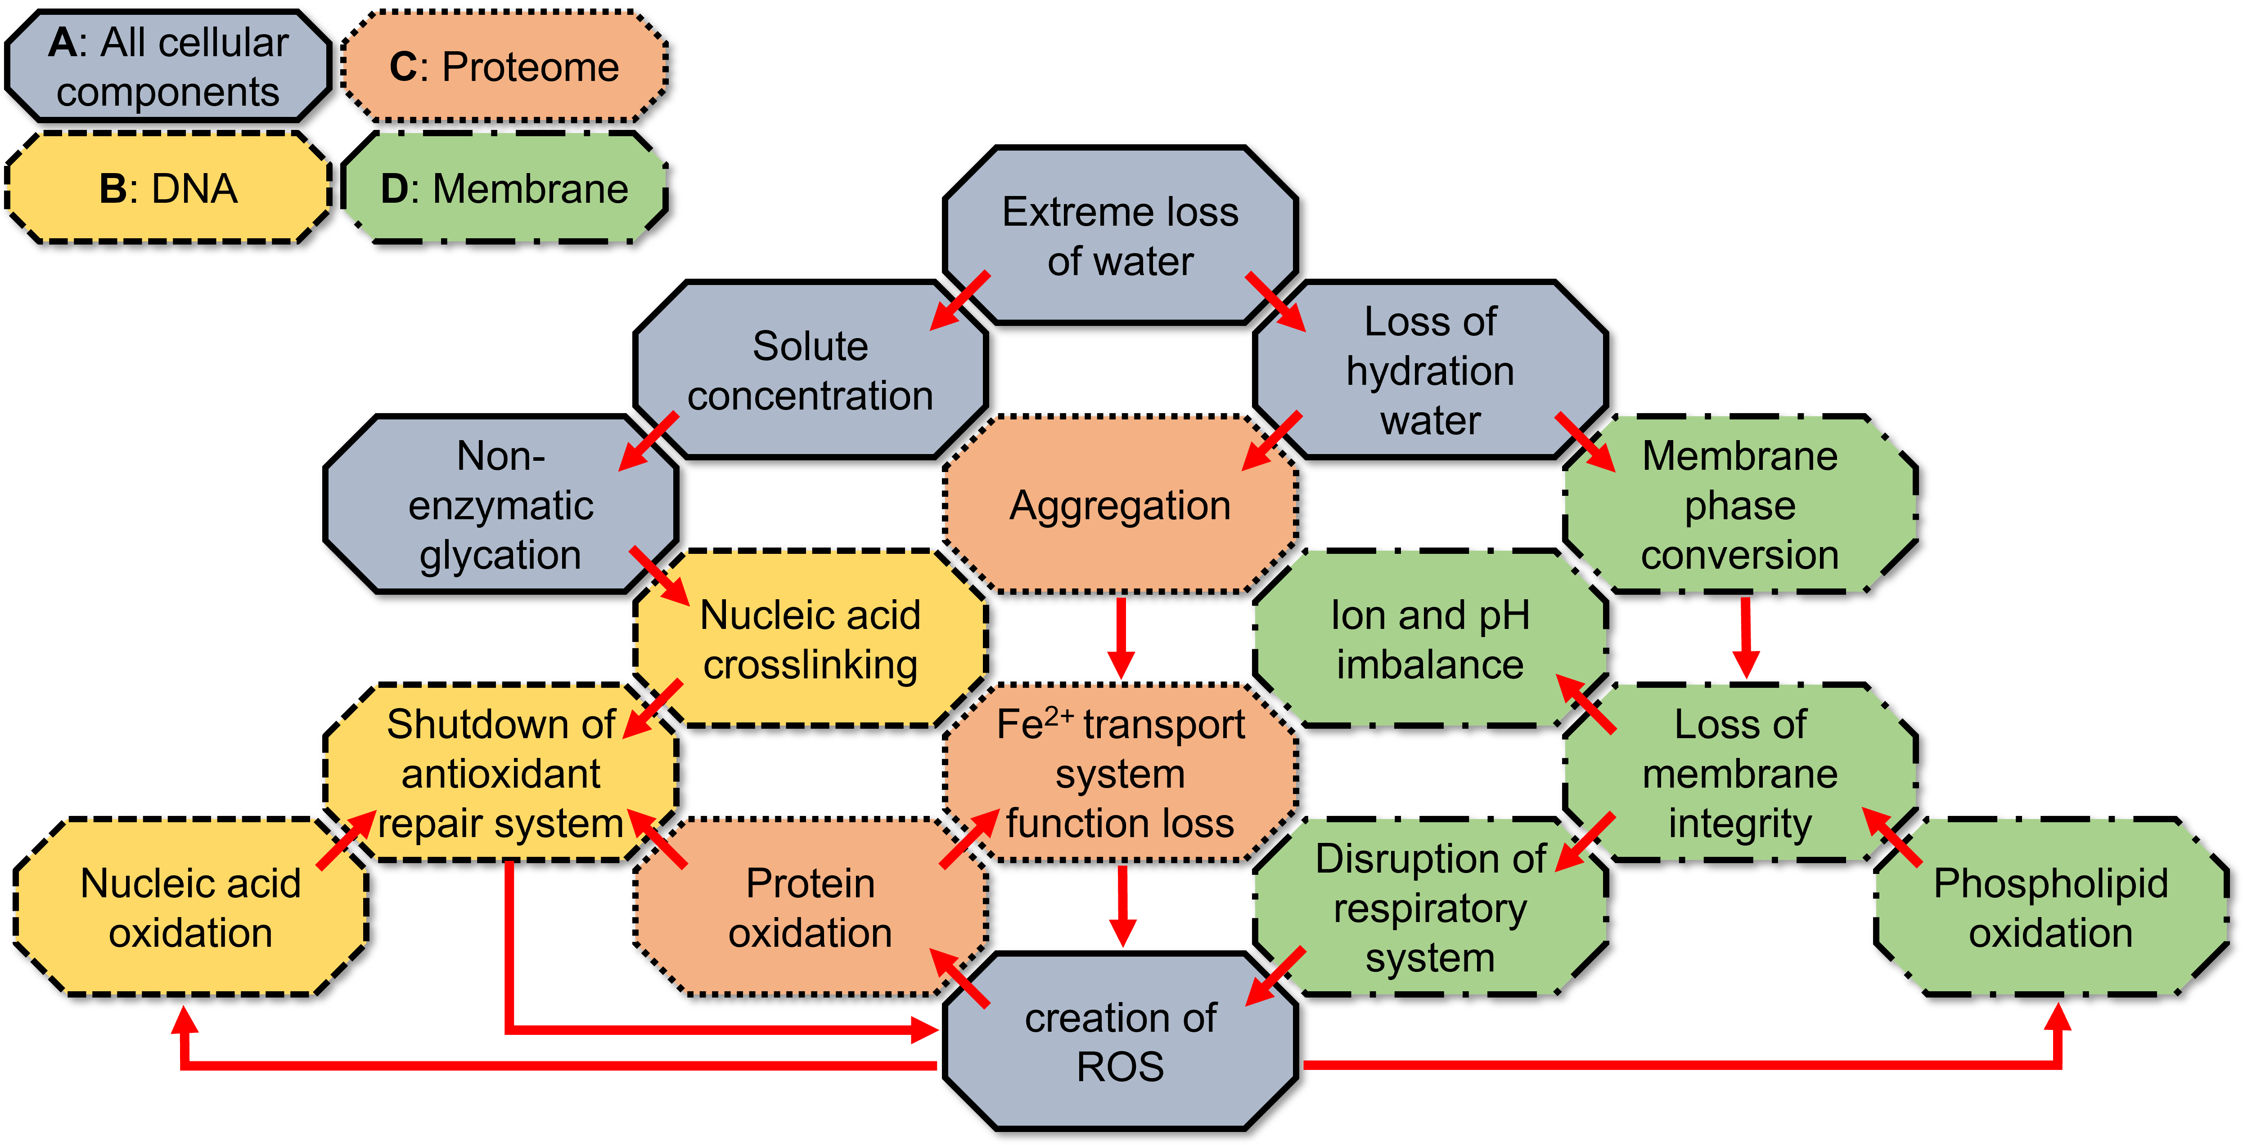
Phases of dry storage
Dehydration:
accumulation of reactive oxygen species [14,16,20]
loss of membrane fluidity [17-19]
DNA/Protein aggregation or cross linking [13-16]
-> special fermentation conditions, formulation, drying techniques [21]
Dry storage:
extremely slow reaction speed -> ideal for storage [24]
vulnerable to UV radiation and oxydation [24]
-> packaging, formulation, (cold storage) [21]
Rehydration:
problems of dehydration continue [13-20]
membrane rupture upon rapid volume change [13,14,17-19]
-> ???
green = solutions in practice
3

