Slide 1
Hypotonic manipulation of the intracellular composition of M. brunneum blastospores to improve desiccation tolerance
Robin Dietsch
Desirée Jakobs-Schönwandt
Alexander Grünberger
Anant Patel

Slide 2
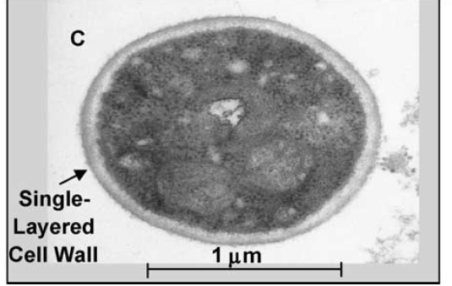
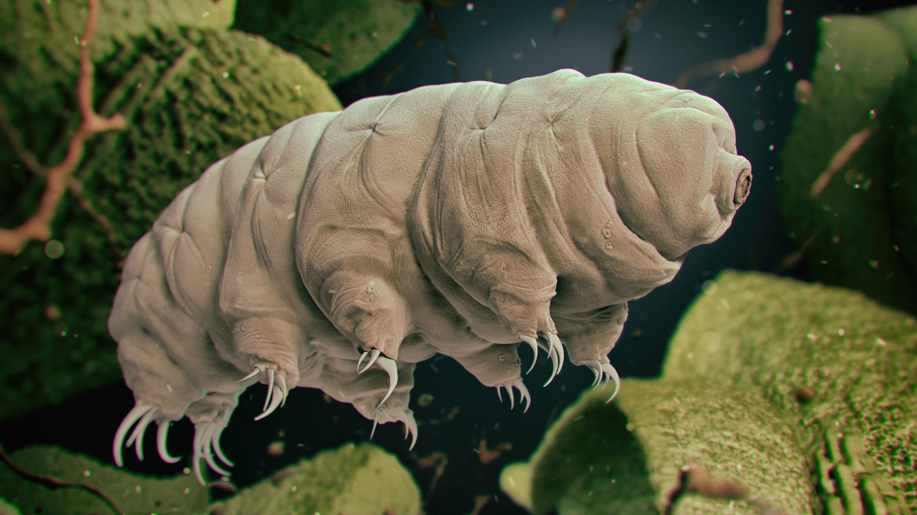
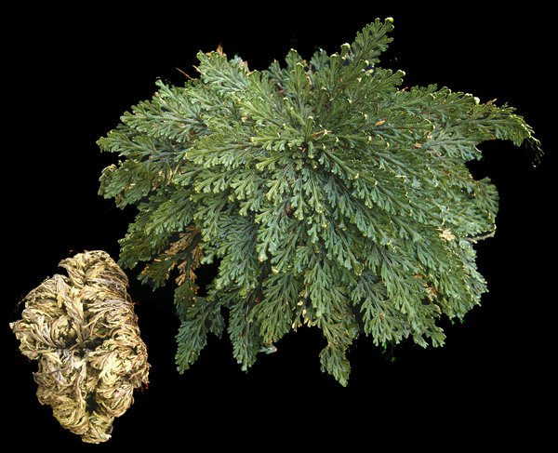
Problem(s)/Theory
Blastospore
A major hurdle of biological pest control: shelf life [1]
  freezing usually too expensive
  drying good option
  however: many organisms not naturally suitable for drying [2]
Drying: Trehalose = „Magic Bullet“
  multiple effects: compatible solute, water replacer, glas formation [3,4,5]
  dependent on amount and cytoplasm composition: homogeneity is desirable [3,4,5]
  up to 20% dry weight in anhydrobiotic organisms [6]
  BUT: hard to dry/formulate (hygroscopic, sticky)
Fig. 1: Transmission electron micrographs of typical (A) aerial conidium and (C) blastospore of M. anisopliae var. acridum. [2]
Tardigrade [7]
Rose of Jericho [8]
1

Slide 3
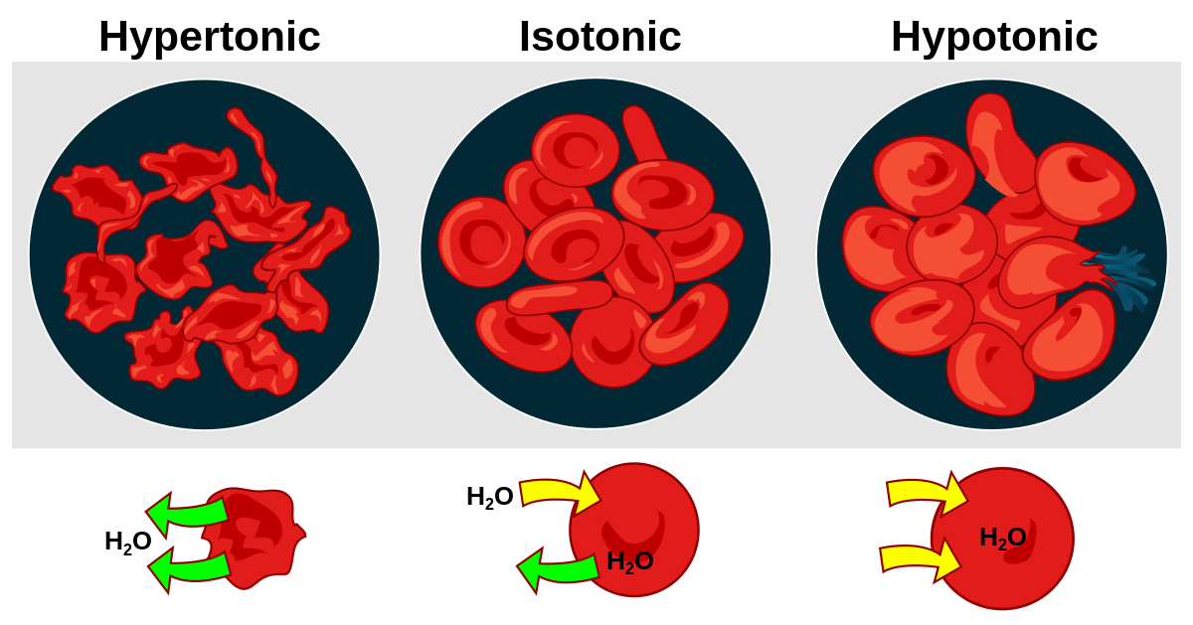
Or can we?
Existing Approaches:
  osmotic stress during fermentation [9]
  incubation in and/or (freeze-)drying in Trehalose [10]
  genetic modification [11]
Cells possess mechanisms to regulate osmotic pressure [3,4,5]
  water channels (seconds)
  ion channels (seconds)
  complex osmolites e.g. sugars, intake and synthesis (minutes – days)
Our brute force approach:
  hypotonic medium forces cells to expel internal solutes (mainly inorganic ions)
  hypertonic medium to load cells with desired solutes (a.k.a. Trehalose)
[12]
2

Slide 4
Design of Experiment
Ctrl - Drying
0.9% NaCl
18 h air drying
0,48 m/s, 20°C, 30% rh
target a_{W} <0,35
Ctrl – 3x Wash
2400 xg
0.9% NaCl
Ctrl - Incubation
0.9% NaCl
20 min
Treat1 A - Drying
0.9% NaCl
18 h air drying
0,48 m/s, 20°C, 30% rh
target a_{W} <0,35
Blastospores
M. brunneum
0.9% NaCl
Treat1 - 3x Wash
2400 xg
0.9% NaCl
Treat1 - Incubation
20 % Trehalose
20 min
Treat1 B - Drying
20 % Trehalose
18 h air drying
0,48 m/s, 20°C, 30% rh
target a_{W} <0,35
Treat2 – 3x Wash
2400 xg
MilliQ (15 Ω)
Treat2 A - Drying
0.9% NaCl
18 h air drying
0,48 m/s, 20°C, 30% rh
target a_{W} <0,35
Treat2 - Incubation
20 % Trehalose
20 min
Treat2 B - Drying
20 % Trehalose
18 h air drying
0,48 m/s, 20°C, 30% rh
target a_{W} <0,35
3

Slide 5
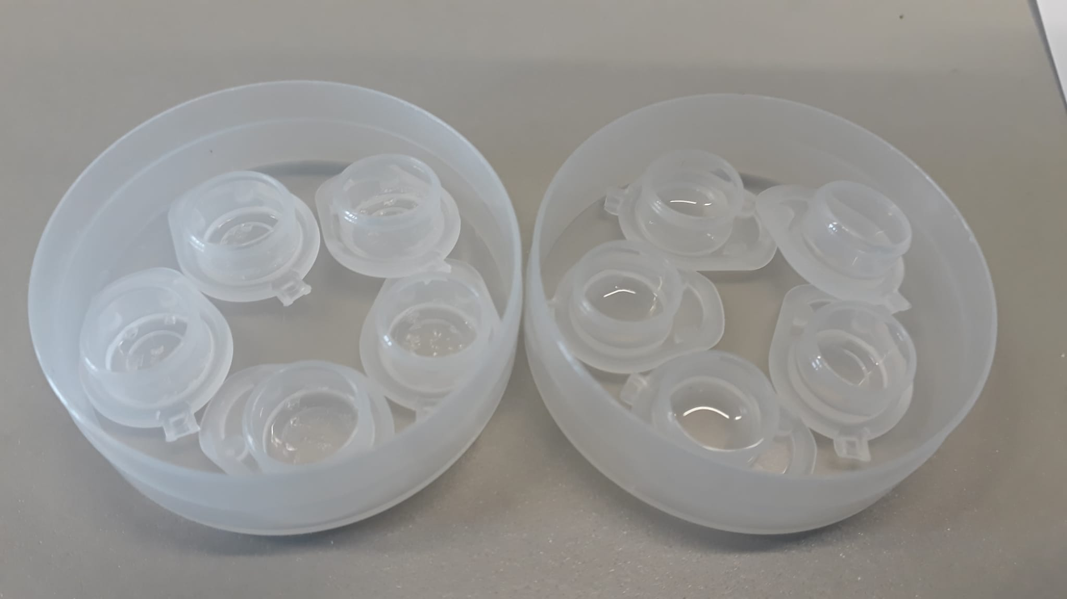
Results - Viability
Hypotheses:
1. MilliQ-washed blastospores exhibit higher
viability due to increased trehalose uptake
2. Residual trehalose is problematic in formulations
Results:
1. Trehalose increases viability
2. MilliQ-wash increases viability
3. drying in trehalose vs. NaCl increases viability, but… final a_{W}
Control: 0,306
Treat 1a: 0,311
Treat 1b: 0,460
Treat 2a: 0,349
Treat 2b: 0,429
Treat 1a Treat 1b
4

Slide 6
Can we relly empty cells?
In repeat experiment:
  Conductivity measurement
  after every step
  Conductivity as indicator for
  ionic solutes
    0.9% NaCl: 16890 μS/cm
    20 % Trehalose: 2.790 μS/cm
    MilliQ 1.321 μS/cm
Results:
  Treat2 „Wash1“ high aW
  -> indicator for ions leaving cells?
  similar (but weaker) effect with
  Treat1 „Trehalose“ -> ion gradient compensation?
5

Slide 7
Summary + Outlook
Summary:
  Increased drying survival when blastospores were washed with milliQ before trehalose application
  first indication for ions leaving cells via conductivity measurement
Outlook:
  actually measure trehalose via hplc (extra AND intracellular)
  how is the viability when dried to exact same a_{W}?
  general improvements to methodology (incubation times, concentrations, etc.)
  different cell types (gram- bacteria)
5

Slide 8
References
[1] Parnell, J.J., R. Berka, H.A. Young, J.M. Sturino, Y. Kang, D.M. Barnhart, and M.V. DiLeo. 2016. From the Lab
to the Farm: An Industrial Perspective of Plant Beneficial Microorganisms. Front. Plant Sci. 7.
[2] Leland, J.E., D.E. Mullins, L.J. Vaughan, and H.L. Warren. 2005. Effects of media composition on submerged culture spores of the entomopathogenic fungus, Metarhizium anisopliae var. acridum Part 2: Effects of media osmolality on cell wall characteristics, carbohydrate concentrations, drying stability, and pathogenicity. Biocontrol Sci Techn. 15:393-409.
[3] Laskowska, E., and D. Kuczyńska-Wiśnik. 2020. New insight into the mechanisms protecting bacteria during desiccation. Curr. Genet. 66:313–318.
[4] Lebre, P.H., P. De Maayer, and D.A. Cowan. 2017. Xerotolerant bacteria: surviving through a dry spell. Nat. Rev. Microbiol. 15:285–296.
[5] Dietsch, R., D. Jakobs-Schönwandt, A. Grünberger, and A. Patel. 2021. Desiccation-tolerant fungal blastospores: From production to application. Current Research in Biotechnology. 3:323–339.
[6] Crowe, J.H. 2010. Water, membranes, and life without water. In Water: The Forgotten Biological Molecule. D. Le Bihan and H. Fukuyama, editors. Pan Stanford Publishing, Singapore. 205-229.
[7] https://www.chemistryworld.com/news/gel-forming-proteins-could-help-tardigrades-survive-extreme- conditions/4014813.article
[8] https://www.lubera.com/de/gartenbuch/unechte-rose-von-jericho-p4399
[9] Ypsilos, I.K., and N. Magan. 2004. Impact of water-stress and washing treatments on production, synthesis and retention of endogenous sugar alcohols and germinability of Metarhizium anisopliae blastospores. Mycol Res. 108:1337-1345.
[10] Zhang, M., H. Oldenhof, B. Sydykov, J. Bigalk, H. Sieme, and W.F. Wolkers. 2017. Freeze-drying of mammalian cells using trehalose: preservation of DNA integrity - Scientific Reports. Sci. Rep. 7:1–10.
[11] Tapia, H., L. Young, D. Fox, C.R. Bertozzi, and D. Koshland. 2015. Increasing intracellular trehalose is sufficient to confer desiccation tolerance to Saccharomyces cerevisiae. Proc. Natl. Acad. Sci. U.S.A. 112:6122–6127.
[12] https://en.wikipedia.org/wiki/Tonicity
10

Slide 9

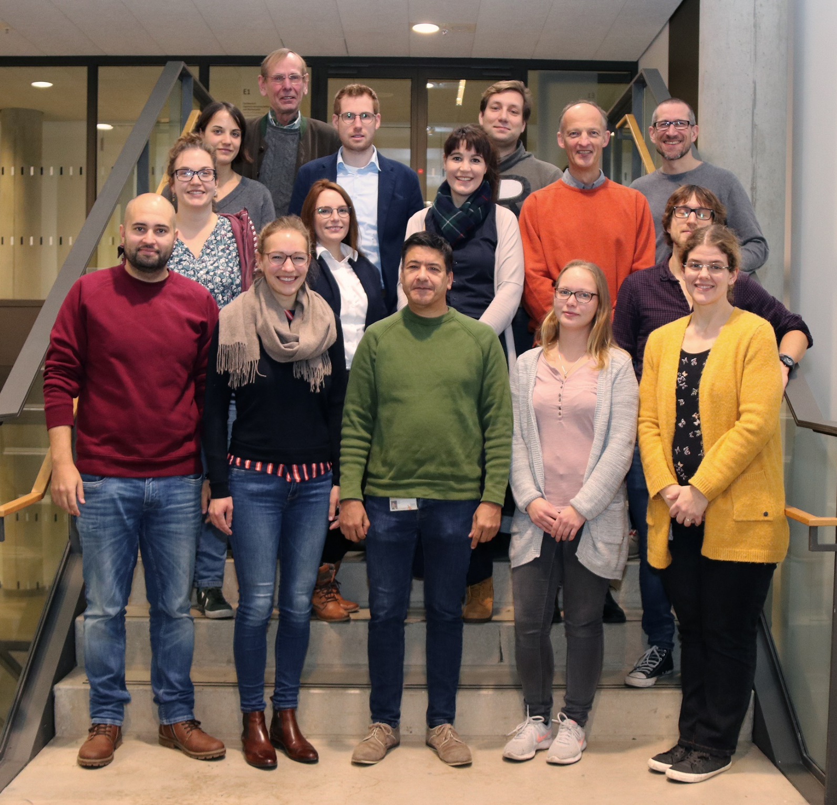







Thank you!
11

