Slide 1
Polymer coating of single Metarhizium brunneum blastospores to improve desiccation tolerance
Robin Dietsch
Desirée Jakobs-Schönwandt
Alexander Grünberger
Anant Patel

Slide 2




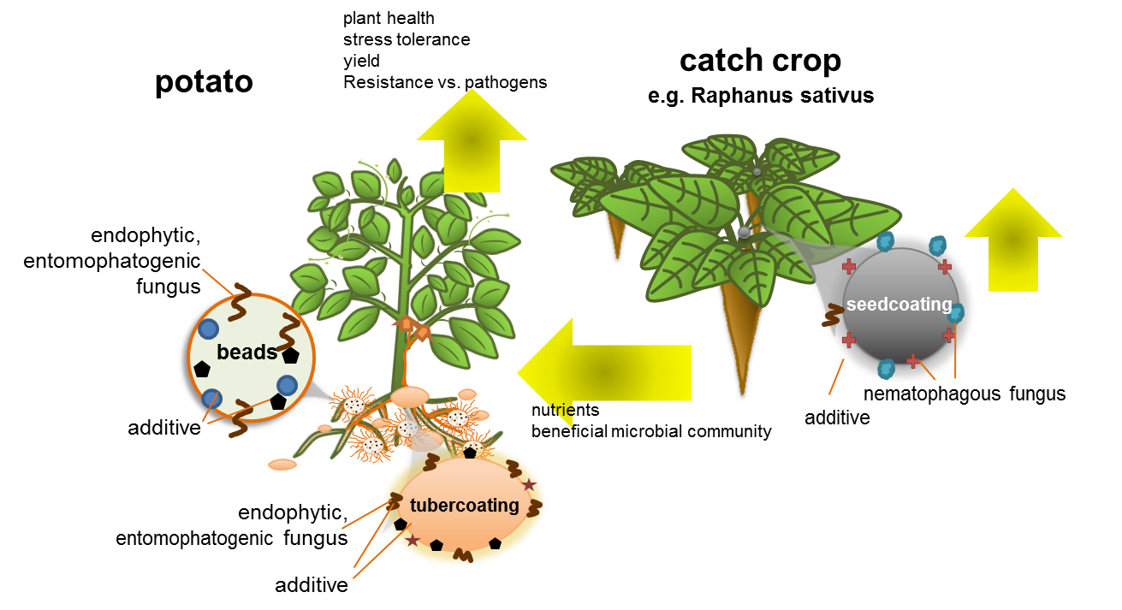
FORK-Project
1

Slide 3
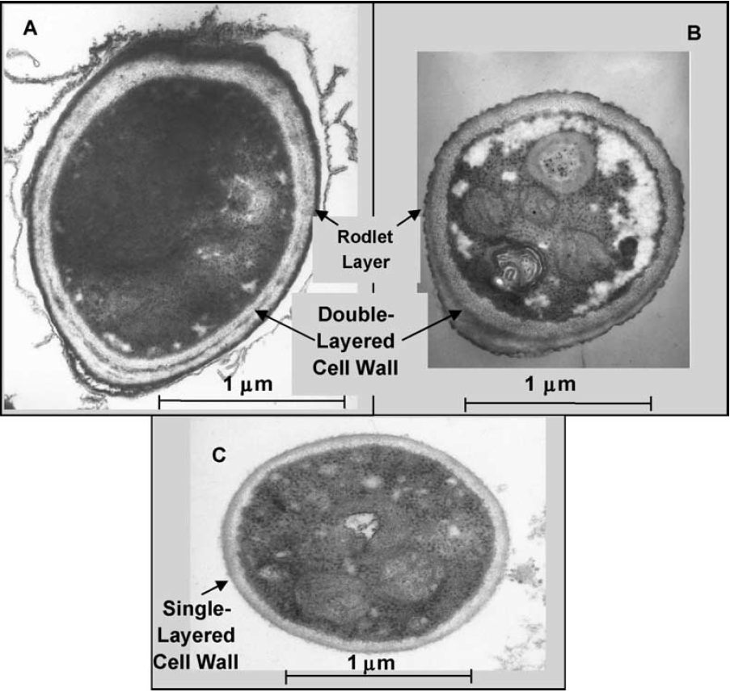
Problem/Importance of the research
M. brunneum is used as biocontrol agent [1,2]
  endophytic entomopathogenic fungus, increases plant fitness [2]
  mainly 2 infective propagules: Aerial conidia and blastospores [3]
  over 70% of mycoinsecticides contain conidia or conida-mycelium mixtures [6]
blastospores:
  high infectivity to insects AND plants[4-8]
  easy, cheap and highly efficient fermentation (compared to aerial conidia)[9,10]
but:
  low desiccation tolerance, necessary for sufficient shelf life [9,11,12]
  shelf life of dried blastospores oftentimes unacceptable for profitable commercialization (2 years @ RT) [9,11,12]
  shelf life significantly lower than aerial conidia [9,11,12]
Aerial Conidium
Blastospore
Fig. 1: Transmission electron micrographs of typical (A) aerial conidium and (C) blastospore of M. anisopliae var. acridum. [7]
2

Slide 4
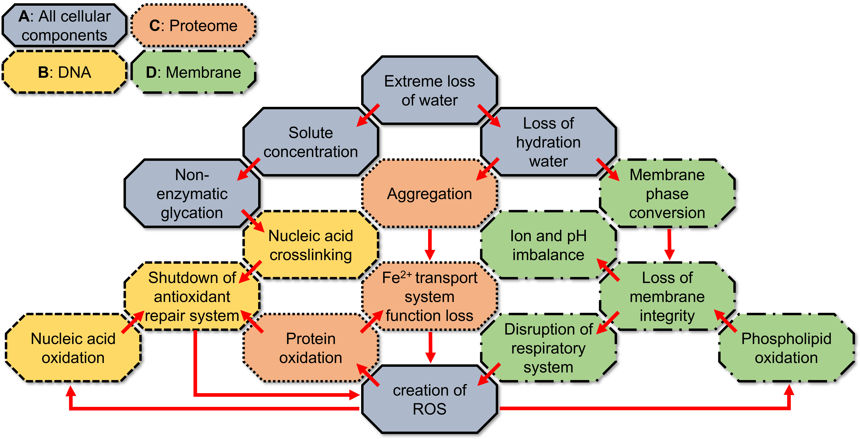
Phases of dry storage
Dehydration:
  accumulation of reactive oxygen species [14,16,20]
  loss of membrane fluidity [17-19]
  DNA/Protein aggregation or cross linking [13-16]
  -> special fermentation conditions, formulation, drying techniques [21]
Dry storage:
  extremely slow reaction speed -> ideal for storage [24]
  vulnerable to UV radiation and oxydation [24]
  -> packaging, formulation, (cold storage) [21]
Rehydration:
  problems of dehydration continue [13-20]
  membrane rupture upon rapid volume change [13,14,17-19]
  -> ???
  green = solutions in practice
3

Slide 5
Impact of rehydration speed
Immediate Rehydration
Decelerated Rehydration
Water Vapor
Water
blastospores
+ support (dry)
blastospores
+ support (dry)
a
b
n = 5
Anova +
post-hoc Tukey test; p<0.001
error = standard deviation
Water reservoir
4

Slide 6
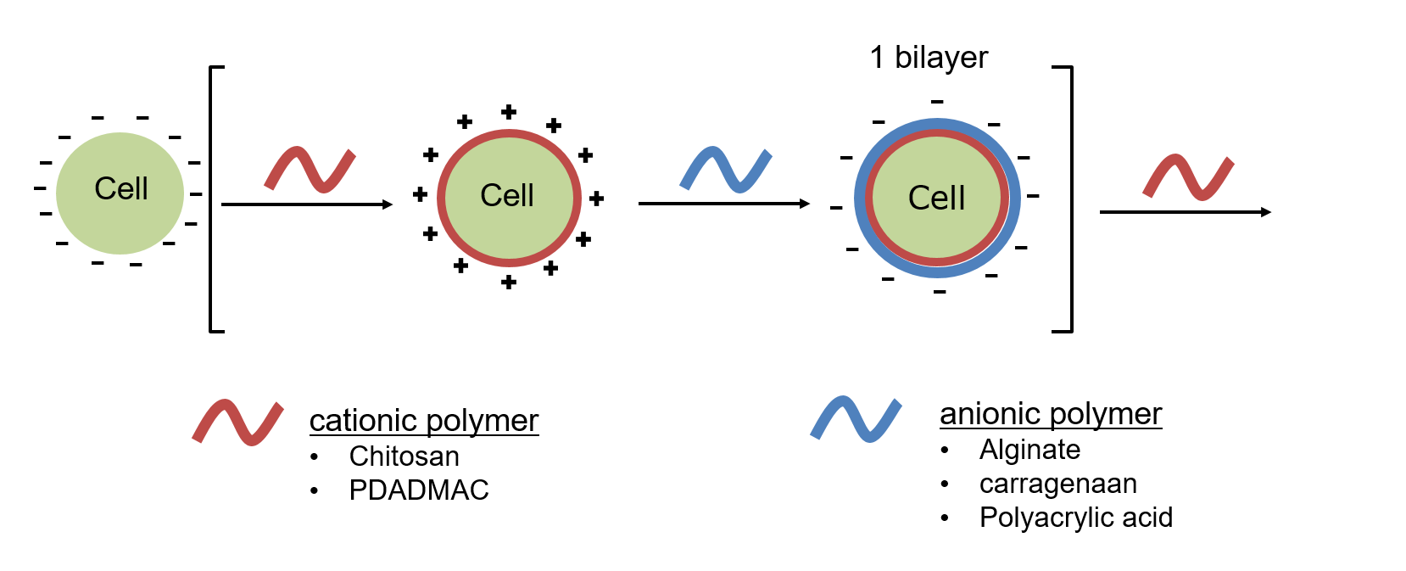
Can rehydration be affected during production?
Aerial Conidium
Blastospore
Concept: Polymer coating of cells.
Working Hypothesis
The addition of a single or multiple polymer layers on top of the blastospore’s single layered cell wall acts as a supplementary diffusion barrier, slowing H₂O influx during rehydration.
This leads to an increase in viability after drying and rehydration.
Fig. 1: Transmission electron micrographs of typical (A) aerial conidium and (C) blastospore of M. anisopliae var. acridum. [7]
5

Slide 7
Performance of coating
increase in desiccation tolerance
  6,88% -> 27,4%
but: lower than decelerated vapor rehydration
  ca. 27,4% vs. 48,25%
blastospore loss in coating procedure
n = 9
Anova + post-hoc Tukey test; p<0.05
error = standard deviation
6

Slide 8
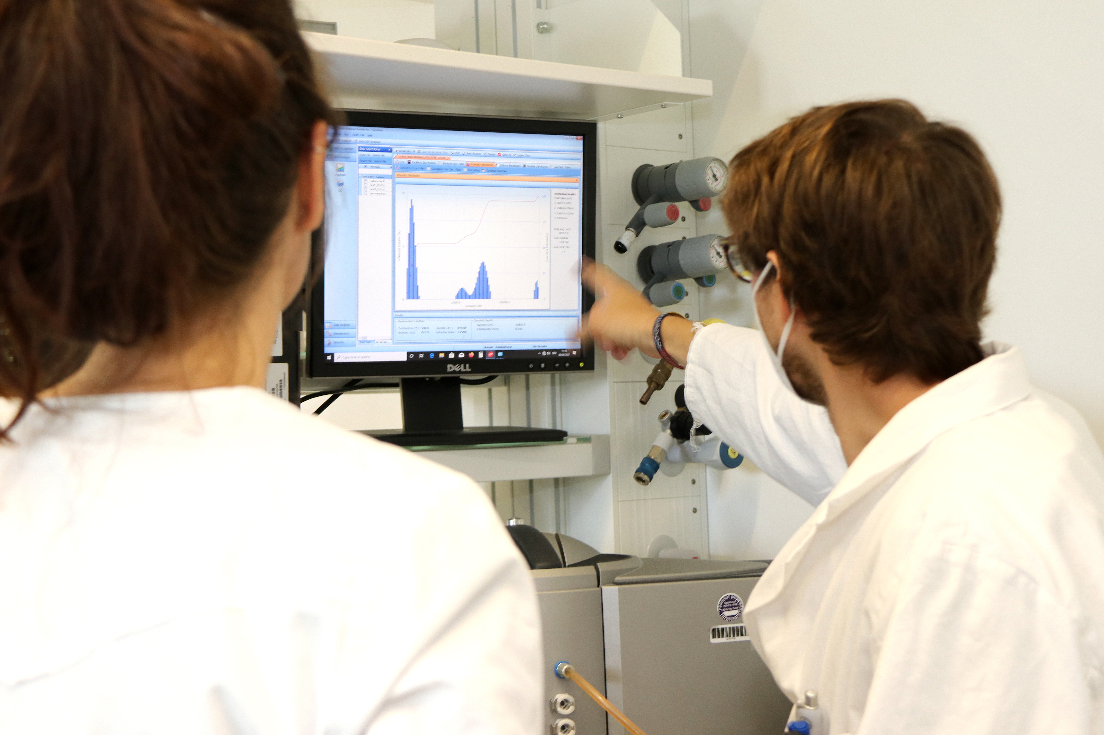
Evidence of Coating
zeta potential
  indication of surface charge
  expected change with polymer layers
blastospores of M. brunneum:
  length:10–25 um; width: ca. 5 um
  heavy sedimentation
  unsuitable for zeta potential measuring
7

Slide 9
Polymer coating + decelerated Rehydration
no significant difference between 3L-immediate rehydration and 0L decelerated dehydration
  n=4!
no significant impact of combined methods
hypothesis:
  water vapor pressure is weaker than adsorption into/through polymer layer
a
a
bc
cd
cd
cd
n = 4
Kruskal-Wallis + Man-Whitney-U-test; p<0.05
error = standard deviation
8

Slide 10
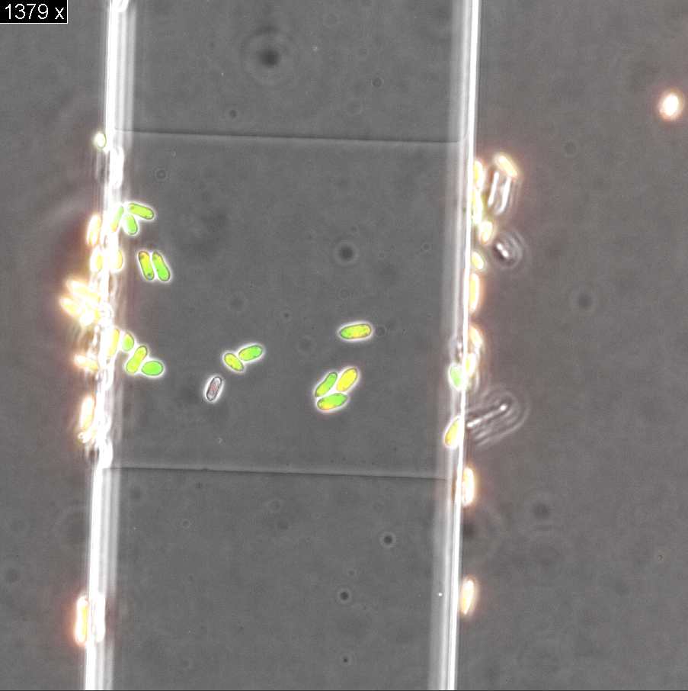
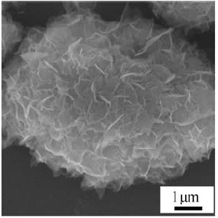
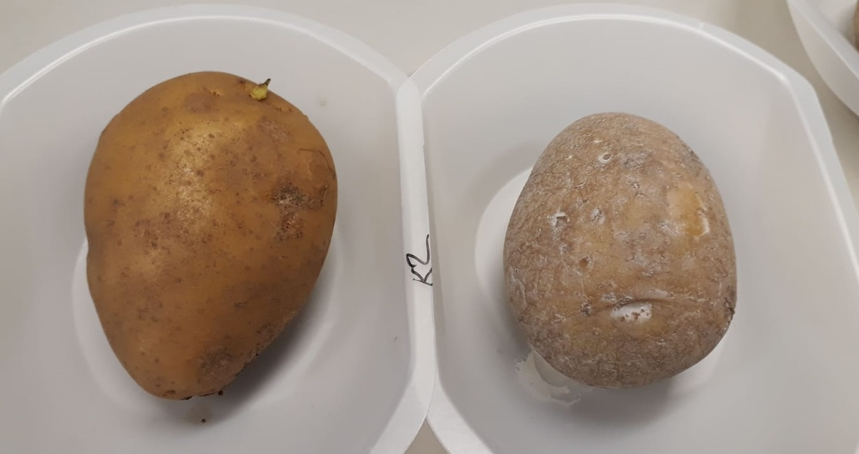
Next steps
Investigation of underlying mechanisms
  assessment of membrane damage (see my poster)
  intracellular effects of coating
  diffusion through coating
Proper evidence of successful coating
  too heavy for zeta potential measurements
  REM/TEM often used in literature
Beyond polymer coating…
  creation of superstructers on top of coating
  combination with other methods
FORK formulation
  storage studies
  Potato tuber coating with coated blastospores
blastospores in microfluidic chip, 1000x
Ca-Phosphate shell mineralized on PDADMAC-PAA coated yeast cell (Wang et al. 2008)
9

Slide 11
References
Krell, V., Jakobs-Schoenwandt, D., Vidal, S., Patel, A.V., 2018. Cellulase enhances endophytism of encapsulated Metarhizium brunneum in potato plants. Fungal Biol-Uk 122, 373-378.
Vidal, S., Jaber, L.R., 2015. Entomopathogenic fungi as endophytes: plant-endophyte-herbivore interactions and prospects for use in biological control. Curr Sci India 109, 46-54.
Krell, V., Unger, S., Jakohs-Schoenwandt, D., Patel, A.V., 2018. Importance of phosphorus supply through endophytic Metarhizium brunneum for root:shoot allocation and root architecture in potato plants. Plant Soil 430, 87-97.
Alkhaibari, A.M., Carolino, A.T., Yavasoglu, S.I., Maffeis, T., Mattoso, T.C., Bull, J.C., Samuels, R.I., Butt, T.M., 2016. Metarhizium brunneum Blastospore Pathogenesis in Aedes aegypti Larvae: Attack on Several Fronts Accelerates Mortality. PLoS Pathog. 12, e1005715.
Carolino, A.T., Gomes, S.A., Pontes Teodoro, T.B., Mattoso, T.C., Samuels, R.I., 2019. Aedes aegypti Pupae are Highly Susceptible to Infection by Metarhizium anisopliae Blastospores. J Pure Appl Microbiol. 13, 1629–1634.
Jackson, M.A., McGuire, M.R., Lacey, L.A., Wraight, S.P., 1997. Liquid culture production of desiccation tolerant blastospores of the bioinsecticidal fungus Paecilomyces fumosoroseus. Mycol Res 101, 35-41.
Leland, J.E., Mullins, D.E., Vaughan, L.J., Warren, H.L., 2005. Effects of media composition on submerged culture spores of the entomopathogenic fungus, Metarhizium anisopliae var. acridum Part 2: Effects of media osmolality on cell wall characteristics, carbohydrate concentrations, drying stability, and pathogenicity. Biocontrol Sci Techn 15, 393-409.
Lohse, R., Jakobs-Schonwandt, D., Vidal, S., Patel, A.V., 2015. Evaluation of new fermentation and formulation strategies for a high endophytic establishment of Beauveria bassiana in oilseed rape plants. Biol Control 88, 26-36.
Reddy, G.V.P., Tangtrakulwanich, K., Wu, S.H., Miller, J.H., Ophus, V.L., Prewett, J., Jaronski, S.T., 2014. Evaluation of the effectiveness of entomopathogens for the management of wireworms (Coleoptera: Elateridae) on spring wheat. J Invertebr Pathol 120, 43-49.
Chong-Rodríguez, M., Maldonado-Blanco, M., Hernández-Escareño, J., Galán-Wong, L., Sandoval-Coronado, C., 2011. Study of Beauveria bassiana growth, blastospore yield, desiccation-tolerance, viability and toxic activity using different liquid media. African Journal of Biotechnology 10, 5736–5742.
Holder, D.J., Kirkland, B.H., Lewis, M.W., Keyhani, N.O., 2007. Surface characteristics of the entomopathogenic fungus Beauveria (Cordyceps) bassiana. Microbiology+ 153, 3448-3457.
Jackson, M.A., Erhan, S., Poprawski, T.J., 2006. Influence of formulation additives on the desiccation tolerance and storage stability of blastospores of the entomopathogenic fungus Paecilomyces fumosoroseus (Deuteromycotina : Hyphomycetes). Biocontrol Sci Techn 16, 61-75.
Boteva, E., Mironova, R., 2019. Maillard reaction and aging: can bacteria shed light on the link? Biotechnol. Biotechnol. Equip. 33, 481–497.
Laskowska, E., Kuczyńska-Wiśnik, D., 2020. New insight into the mechanisms protecting bacteria during desiccation. Curr. Genet. 66, 313–318.
Franks, F., 1988. Protein Hydration. SpringerLink, 127–154.
Lebre, P.H., De Maayer, P., Cowan, D.A., 2017. Xerotolerant bacteria: surviving through a dry spell. Nat. Rev. Microbiol. 15, 285–296.
Raghunathan, V.A., Katsaras, J., 1996. Lβ′→Lc′ phase transition in phosphatidylcholine lipid bilayers: A disorder-order transition in two dimensions. Phys. Rev. E 54, 4446–4449.
Rangamani, P., Katira, S., Smit, B., Oster, G., 2014. Lipid Tilt Regulates Ripple Phase Behavior in Lipid Bilayer. Biophys. J. 106, 509a.
Scheve, C.S., Gonzales, P.A., Momin, N., Stachowiak, J.C., 2013. Steric Pressure between Membrane-Bound Proteins Opposes Lipid Phase Separation. J. Am. Chem. Soc. 135, 1185–1188.
França, M.B., Panek, A.D., Eleutherio, E.C.A., 2007. Oxidative stress and its effects during dehydration. Comp. Biochem. Physiol. A: Mol. Integr. Physiol. 146, 621–631.
Mascarin, G.M., Jackson, M.A., Behle, R.W., Kobori, N.N., Delalibera, I., 2016. Improved shelf life of dried Beauveria bassiana blastospores using convective drying and active packaging processes. Appl Microbiol Biot 100, 8359-8370.
Kurtmann, L., Carlsen, C.U., Risbo, J., Skibsted, L.H., 2009. Storage stability of freeze–dried Lactobacillus acidophilus (La-5) in relation to water activity and presence of oxygen and ascorbate. Cryobiology 58, 175–180.
Bodzen, A., Iaconelli, C., Charriau, A., Dupont, S., Beney, L., Gervais, P., 2020. Specific Gaseous Conditions Significantly Improve Lactobacillus casei and Escherichia coli Survival to Freeze Drying and Rehydration. Applied food technology 7, 2.
Potts, M., 1994. Desiccation Tolerance of Prokaryotes. Microbiol Rev 58, 755-805.
García, A.H., 2011. Anhydrobiosis in bacteria: From physiology to applications. undefined.

Slide 12
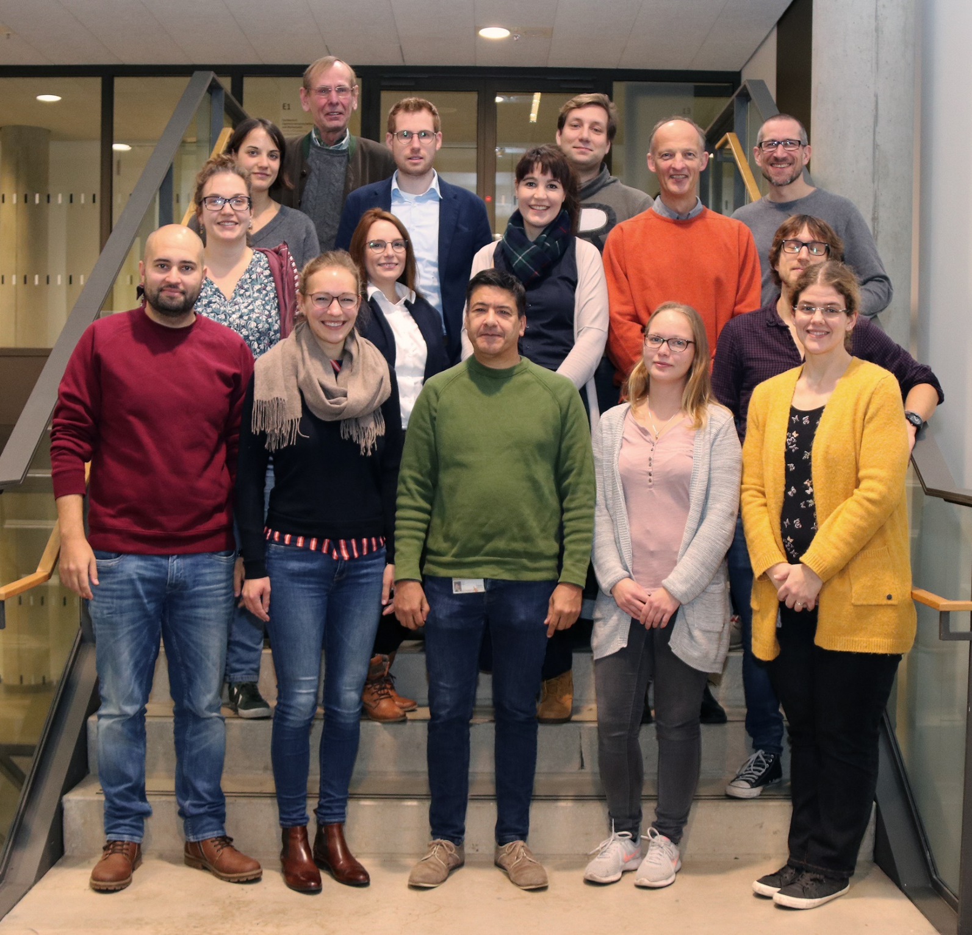




Thank you!
10

